Slide 1
Deep Learning 101
Saifeldeen Adel, CEO

Slide 2
Agenda
What is DL
Neural Network Intuition
Neural Network basic pipeline
Forward/Backward propagation, loss functions, training loops
Building and training a simple Linear regression model (PyTorch)
Break
Activation functions, introducing non-linearity

Slide 3
02
What is DL?

Slide 4
Deep Learning
Deep learning is a subset of machine learning focused on models called neural networks with many layers (hence "deep"). These models can automatically learn complex patterns and representations from large amounts of data.
Commonly used in complex applications involving image recognition, speech recognition/transcribing, image/speech generation, etc.

Slide 5
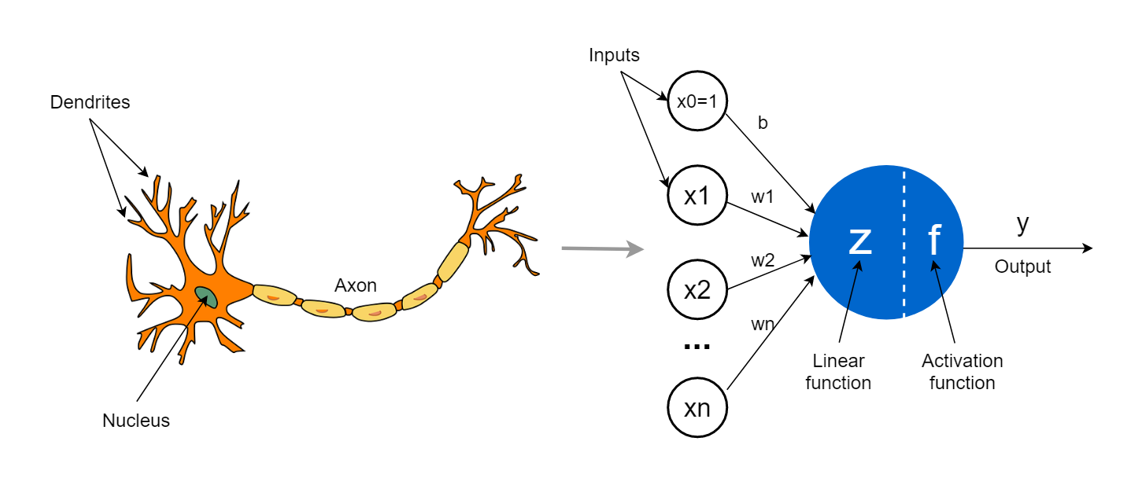
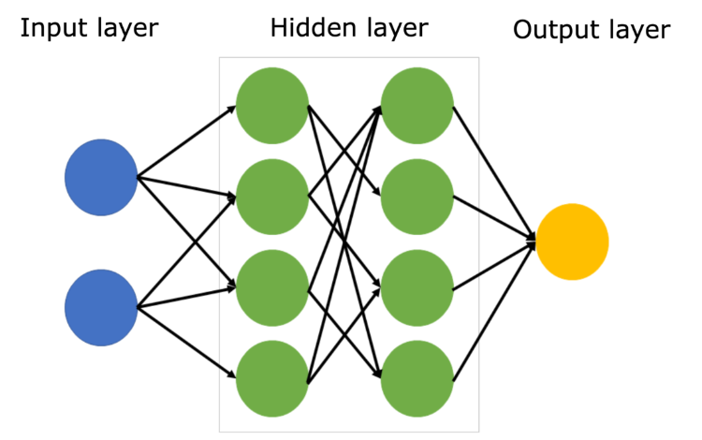
Neural Networks
Neural networks are modeled after the brain’s neurons. A neuron takes in a signal as input and sends out another signal as output.
A neural network can be thought of as a series of layers of nodes (neurons), where each node represents a mathematical operation.

Slide 6
Neural Networks
The simplest neural network is a perceptron, which takes several inputs, multiplies them by weights, adds a bias to produce the output.
If we stop here, this produces a linear output. Later, we will change this linear output by passing it into activation functions to introduce non linearity.

Slide 7
Stepping Through
a Neural Network!

Slide 8
1 - Forward propagation
In forward propagation, information flows from the input layer, through any hidden layers, to the output layer.
At each neuron, the input is multiplied by weights, summed up, and then passed through an activation function then onto the next layer.
Vectorization is key. Let’s see it on a small scale and how it helps manage multiple weights and multiple layers
(2 x 3 x 1 network)

Slide 9
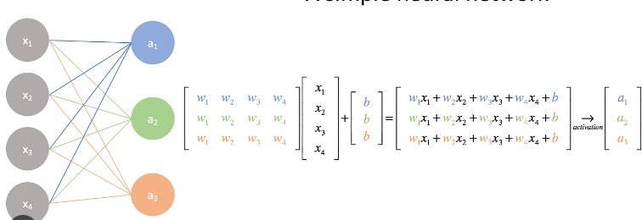
1 - Forward propagation

Slide 10
2 - Calculating Cost
After reaching the output layer, we will use our cost function to calculate the error.
The cost function will tell us how well the network is doing by comparing the network’s predictions to the actual correct answers.
Remember MSE (Mean Square Error)?

Slide 11
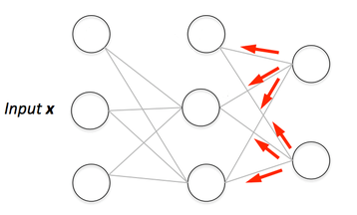
3 - Backpropagation
Imagine receiving a bad report card. What do you do?
Backpropagation is the process where the network learns from its mistakes by adjusting the weights.
After calculating the cost, the network works backward, from the output layer to the input layer, adjusting the weights to reduce the error next time.
How does it know which weight to adjust and by how much? Calculus. A lot of it.

Slide 12
3 - Backpropagation
Every hidden node j is responsible for a fraction of the error E in each of the output nodes it connects to.
E is then divided according to the strength of the connection between the hidden node and to the output node (based on the weights)
The “blame” is then propagated back to provide the error values for the hidden layer
So that each weight now has its own error and can perform its own gradient computation. Remember gradient descent?

Slide 13
Putting it all together
Forward propagation

Slide 14
Putting it all together
Forward propagation
-> Calculate cost (error)

Slide 15
Putting it all together
Forward propagation
-> Calculate cost (error)
-> Backpropagation

Slide 16
Putting it all together
Forward propagation
-> Calculate cost (error)
-> Backpropagation
-> Optimize (gradient descent)

Slide 17
Putting it all together
Forward propagation
-> Calculate cost (error)
-> Backpropagation
-> Optimize (gradient descent)
-> Repeat

Slide 18
Putting it all together
Forward propagation
-> Calculate cost (error)
-> Backpropagation
-> Optimize (gradient descent)
-> Repeat
We now have a training loop!
Repeat this for enough times and your error will be as close to 0 as possible (hopefully) and your parameters/weights will be adjusted to their correct values.

Slide 19
Hands-on
Let’s train a neural network!

Slide 20
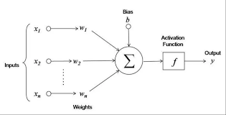
Activation functions
Activation functions allow the network to learn non-linear patterns in the data. Without them, no matter how many layers you add, the network will just behave like linear regression.
They decide whether a neuron "fires" (activates) or not based on the input.

Slide 21
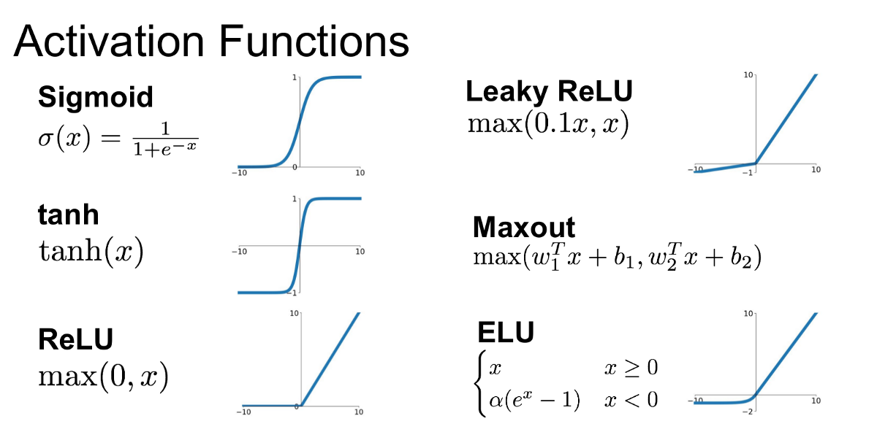

Slide 22
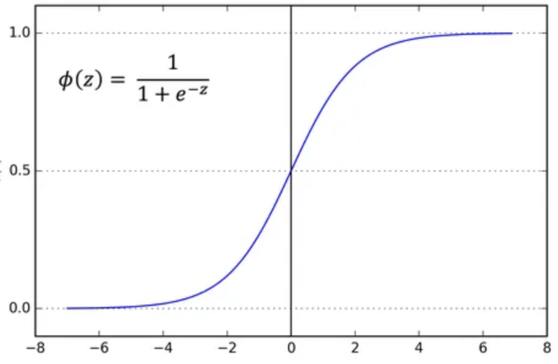
Activation functions - Sigmoid
The sigmoid function is a smooth, S-shaped curve that maps any real number input into a value between 0 and 1.
Think of it like a soft switch: instead of turning fully on or off, like a traditional switch, it allows a smooth transition from off (0) to fully on (1).
Limitations? Back propagation and values approaching zero.

Slide 23
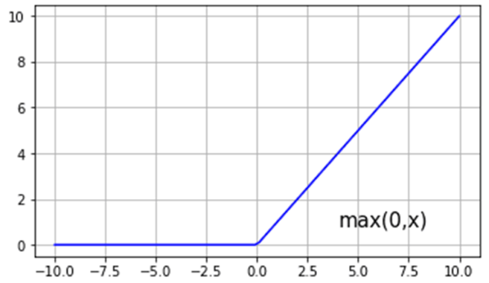
Activation functions - ReLU
Think of ReLU like a gate: when the input is positive, the gate opens fully and lets the signal pass through. When the input is negative, the gate closes and blocks the signal (output is 0).
This creates a piecewise linearity. Why is this not linear?
f(x)=x when x>0, f(x)=0 when x<0
Limitations? Too many dead neurons.

Slide 24
Activation functions - ReLU
Think of ReLU like a gate: when the input is positive, the gate opens fully and lets the signal pass through. When the input is negative, the gate closes and blocks the signal (output is 0).
This creates a piecewise linearity. Why is this not linear?
f(x)=x when x>0, f(x)=0 when x<0

Slide 25
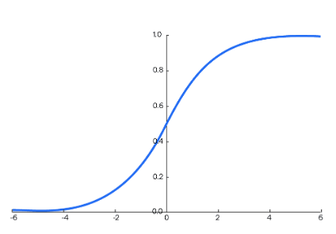
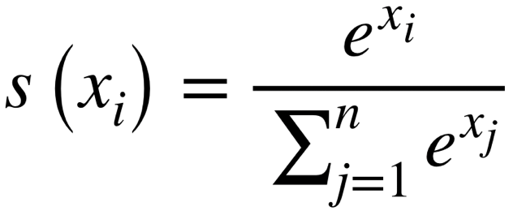
Activation functions - Special - Softmax
Softmax is used in multi class classification problems to convert a vector of raw class scores into probabilities that sum to 1.
Each score is divided by the sum of the exponentials of all scores in the vector.
Introduces non linearity the same way but it works with connecting multiple class outputs together

Slide 26
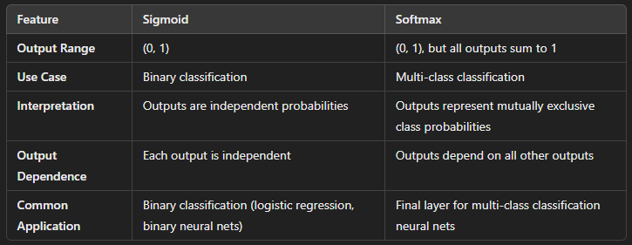
Activation functions - Special - Softmax

Slide 27
Let’s Play
Watch activation functions at play.

Slide 28
Thank you!

